Slide 1

Potato Leaf Disease Detection
Project Members
D Soma sekhar reddy - AP21110011377
G Murali krishna - AP21110011388
S Sanjeev reddy - AP21110011392
M Rahul - AP21110011393
N Vamshi krishna – AP21110011403
Project Mentor
Dr.Sanjay kumar

Slide 2
01
Introduction
02
Objective
03
Methodology
04
Image preprocessing
Contents
05
Image augmentation
06
Classification
07
Statistical analysis
08
Future work
09
Conclusion

Slide 3
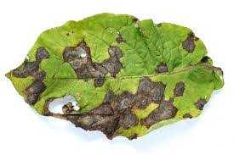
Introduction
This project aims to use Convolutional Neural Networks (CNNs) and deep learning techniques to detect and classify potato leaf diseases like Early Blight (EB) and Late Blight (LB). These diseases often hinder optimal potato plant growth and yield. Timely identification is crucial to prevent significant crop losses. The focus is on creating an accurate model capable of distinguishing healthy potato leaves from those affected by common diseases. By leveraging deep learning, this initiative aims to offer farmers a tool for quick disease identification and management, ultimately improving crop yield and quality in precision agriculture

Slide 4

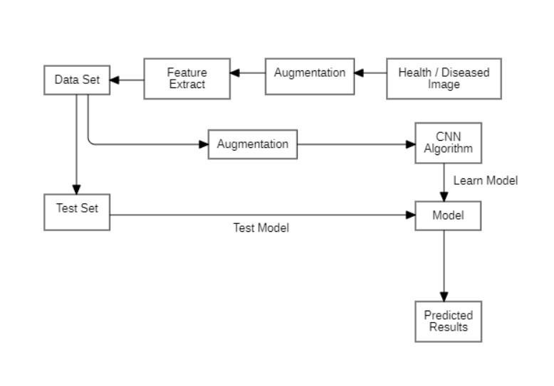
Objective

Slide 5
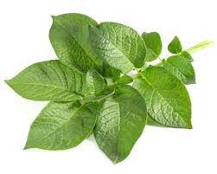
Objective
Potato farmers often suffer big money losses due to diseases like Early Blight (from fungi) and Late Blight (from specific microorganisms). Spotting these diseases early is super important—it helps farmers treat them fast, stopping big losses. Early Blight and Late Blight need different treatments, so knowing which one is on the plant matters a lot. Using fancy tech like Convolutional Neural Networks (CNNs) and Deep Learning, this project wants to help farmers diagnose plant diseases accurately. The goal is to give farmers a good tool to find diseases quickly, so they can save crops, waste less, and avoid losing money.

Slide 6

Methodology
Convolutional Neural Networks (CNNs) work in spotting leaf diseases from images. CNNs have layers of perceptrons, making them great at handling complex data. It shows how to use CNNs step-by-step: getting leaf pictures, turning them into arrays, organizing the database, training the model, testing it with new images, and showing where diseases are and how to treat them. Keeping things consistent is key, like making all images the same size and having accurate labels for the data. The CNN's effectiveness depends on things like the number and size of filters it uses.

Slide 7

Image preprocessing
Preprocessing in image classification involves scaling, data augmentation, and normalization, crucial for the model to grasp image details. It prevents overfitting, letting the model work well with new data. Data augmentation, like flips or resizing, boosts model strength. Using a Sequential model's rescaling layer, images are set between 0 and 1. Normalization keeps data consistent, improving accuracy during training. These steps are vital for readying data and ensuring the model can classify images well without getting too specialized. Overall, preprocessing plays a pivotal role in fine-tuning the model's ability to understand images and classify them effectively while avoiding overfitting.

Slide 8
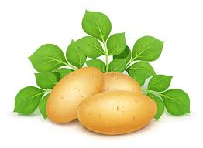
Image augmentation
A method known as data augmentation involves generating new training data from existing datasets. In this implementation, the Keras Sequential model, equipped with multiple image augmentation layers, was employed to execute data augmentation. Various layers, including Random Flip, Random Rotation, Random Zoom, Random Height, and Random Width, were utilized to enrich the dataset. The Random Flip layer, for instance, plays a role in assisting the model in learning features irrespective of the orientation of the input image, as it randomly flips the input image either horizontally or vertically. This augmentation technique contributes to a more diverse and robust training dataset, enhancing the model's ability to generalize and recognize patterns effectively.

Slide 9
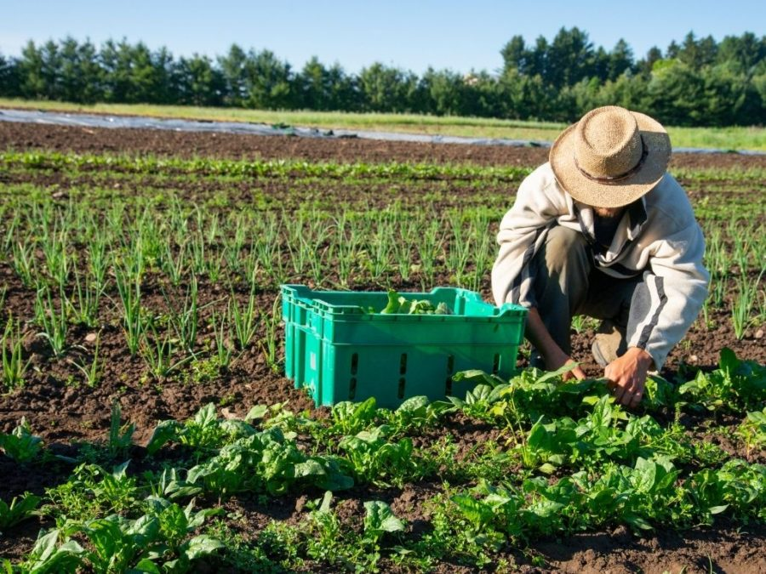
Feature Extraction
The architecture employed for feature extraction in this context is the Convolutional Neural Network (CNN). The model is structured with multiple convolutional layers, each characterized by distinct numbers, sizes, and activation functions of filters. Following these convolutional layers, max-pooling layers are incorporated to down 6 sample the feature maps, reducing the spatial dimensionality of the input data. This design facilitates the effective extraction of features from the input images, utilizing a combination of convolutional and pooling layers to discern patterns and spatial relationships within the data

Slide 10
Classification CNN
The CNN used for image categorization has six convolutional layers with filter counts of 32, 256, 256, and 32, each responsible for extracting different image features. After these layers, there's a max pooling layer that reduces the output size, aiding spatial dimension reduction. Rectified Linear Unit (ReLU) activation functions are applied throughout the convolutional layers, adding non-linearity for better feature learning. The final convolutional layer's output goes through global average pooling to shrink dimensions before reaching a fully connected output layer. This output layer uses softmax activation to predict classes based on probabilities. The design ensures effective feature extraction and classification, boosting the model's ability to categorize images accurately. The architecture is structured to optimize feature extraction and enhance the model's proficiency in image categorization.

Slide 11
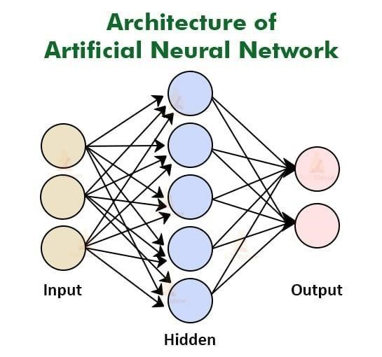
ANN
The ANN used for image categorization had six densely connected layers with varying neuron counts: 32, 256, 256, and 32 neurons in each layer. It included a dropout layer set at 0.25 rate, helping prevent overfitting by randomly deactivating neurons during training. Throughout the network, Rectified Linear Unit (ReLU) activation was applied, aiding in learning intricate patterns in the input data. The final densely connected layer's output went to a fully connected output layer using softmax activation, predicting class likelihoods. This architecture helped extract features effectively and classify images, boosting the model's ability in image categorization. The design ensured effective learning, preventing overfitting, and enabling the model to understand complex patterns for accurate image classification.

Slide 12
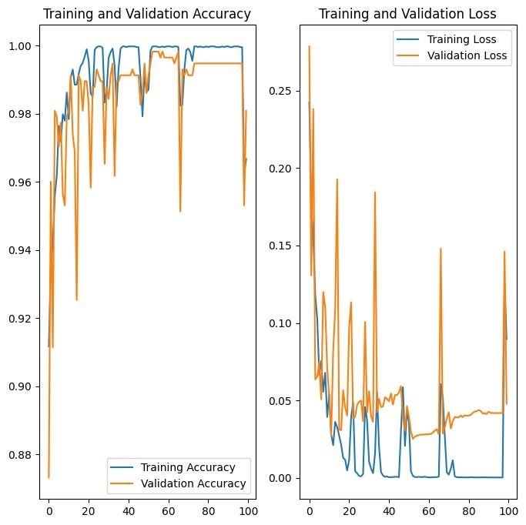
Statistical analysis CNN
Training Accuracy versus Validation Accuracy and Training and Validation Loss of CNN

Slide 13
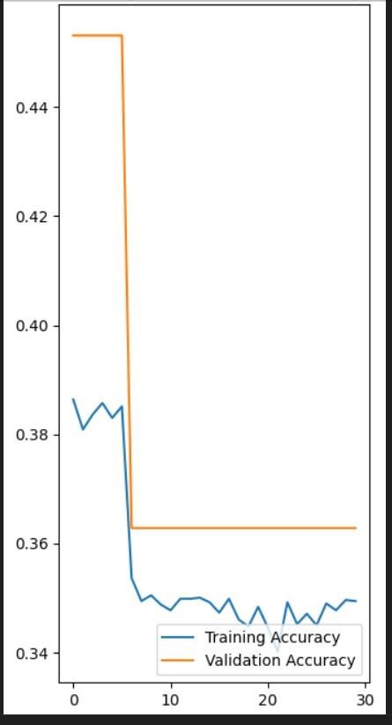
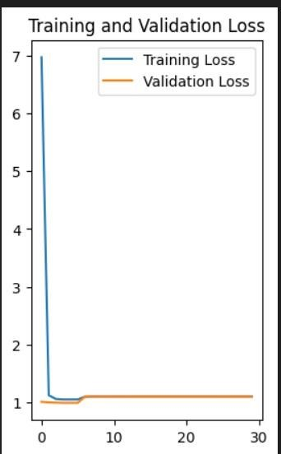
Statistical analysis ANN
Training Accuracy versus Validation Accuracy and Training and Validation Loss of ANN

Slide 14
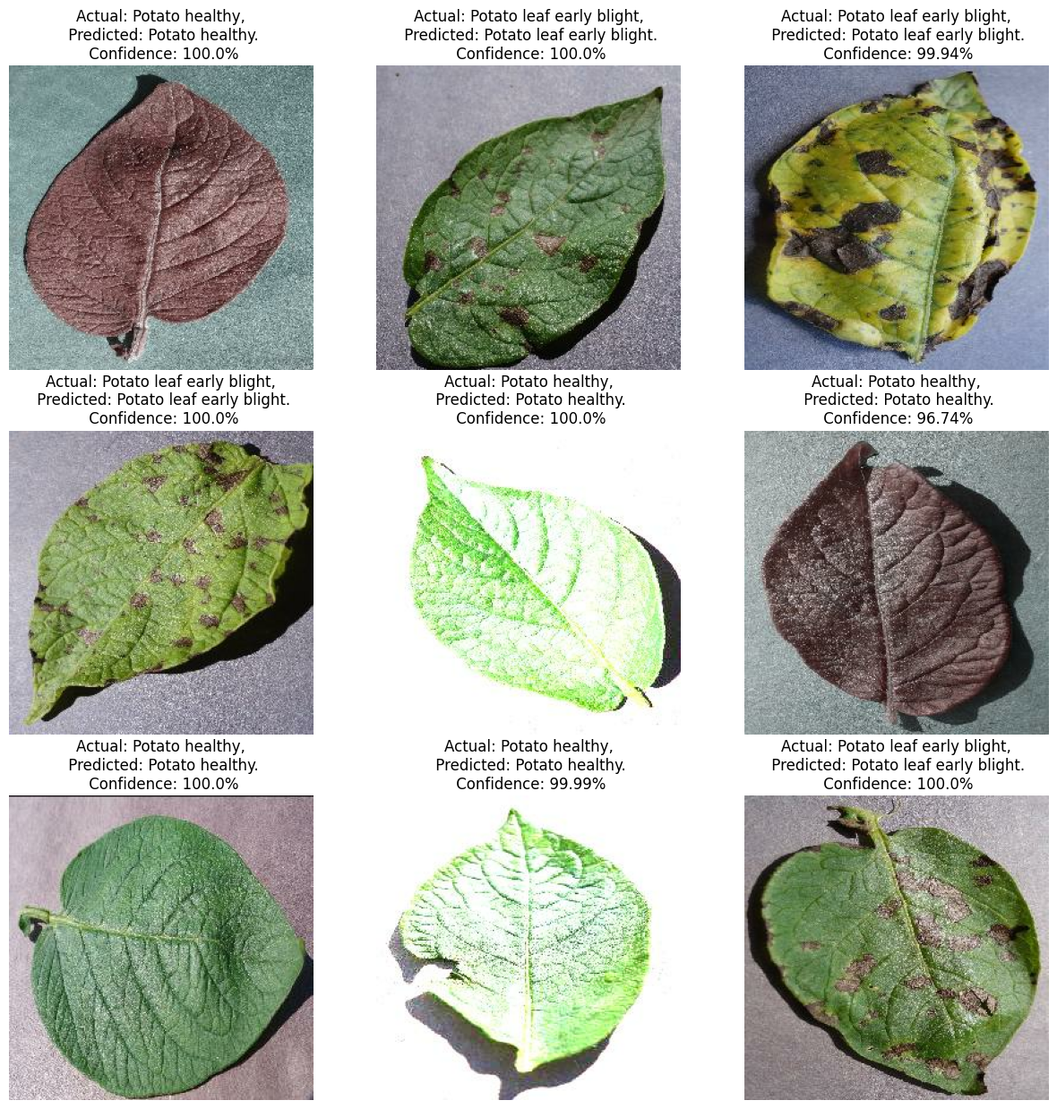
Results for CNN

Slide 15
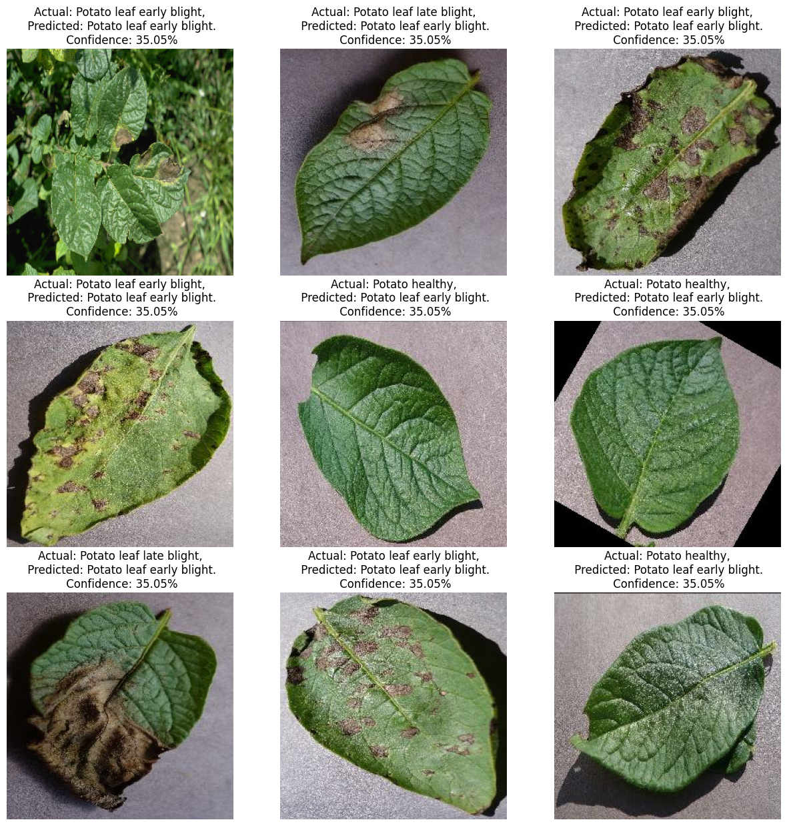
For ANN

Slide 16
Model Analysis
Model | Accuracy | Loss | Val_Accuracy | Val_loss
CNN | 99.66% | 1.17% | 99.65% | 0.85%
Model | Accuracy | Loss | Val_Accuracy | Val_loss
ANN | 34.95% | 9.68% | 36.28% | 0.52%

Slide 17
Future work
This special phone app is made for farmers who can't read. It helps them with farming using only their voice. It's really easy to use and doesn't need any reading. The main thing it does is find and handle leaf diseases that can hurt the farm. Farmers who can't read can find out what's wrong with their plants using a big list of leaf diseases in the app. Also, there are pictures that show how much of the leaves are damaged. This helps farmers see how bad the disease is. This new app helps farmers who can't read to learn and manage their farms better. It makes their farms better and helps them earn more money. It's like a special helper just for them.

Slide 18
Conclusion
The main goal is to help farmers spot and identify diseases on potato leaves accurately. By using neural networks that mimic how our brains work, a new method has been created, a step up from older models. They've developed a CNN model with a super high 99% accuracy in spotting potato leaf diseases. Adding a GPU makes the model faster and even more accurate, saving on costly expertise. This method is cost-effective and helps quickly identify leaf problems, giving advice on how to fix them fast. Plus, it's easy to access—farmers can install it on their phones to snap pictures and find out what's wrong with their potato plants. This new way helps farmers quickly and accurately figure out what's up with their plants, giving them a handy tool to manage plant health.

Slide 19
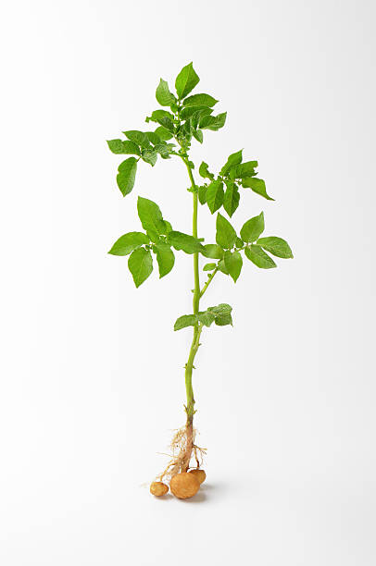
Thank You

